Slide 1

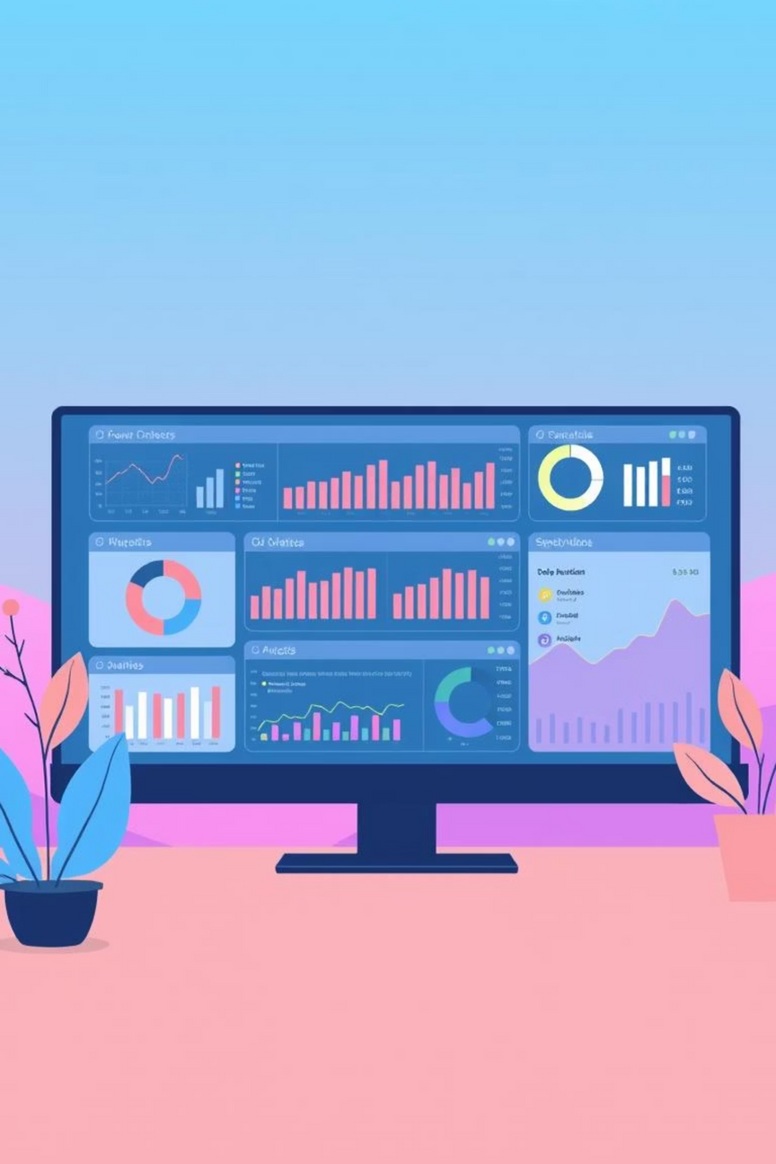
Personal Finance Dashboard: A 3-Year Overview
This Power BI dashboard offers a comprehensive overview of income, expenses, and savings trends from 2021 to 2023. It provides visual breakdowns and categorisations to support informed financial decision-making.
Notes:
1

Slide 2
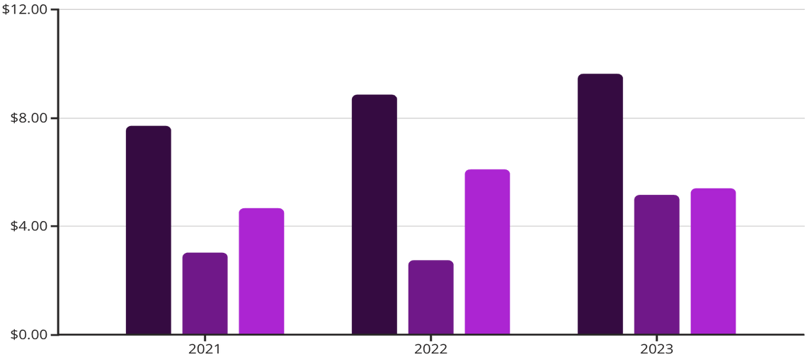
KEY FINANCIAL METRICS
Income, Expense, and Savings Overview (2021-2023)
Income Growth: Steady increase from ₹7.71L in 2021 to ₹9.64L in 2023, showcasing consistent financial uplift.
Expense Rise: Expenses grew from ₹3.03L in 2021 to ₹5.14L in 2023, necessitating a closer look at spending patterns.
Savings Fluctuation: Savings peaked at ₹6.10L in 2022 but dipped slightly to ₹5.39L in 2023. Despite this, the savings percentage remains strong at 64% of total income, indicating robust financial health.
Income (Lakhs INR)
Expenses (Lakhs INR)
Savings (Lakhs INR)
Notes:
2

Slide 3
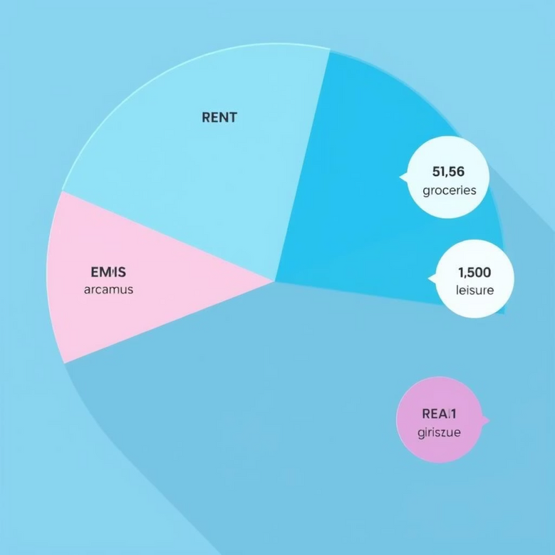
UNDERSTANDING SPENDING HABITS
Category-wise Expenses (2023)
37%
23%
House Rent
EMIs
Largest expenditure at ₹1.9L, highlighting housing as a primary financial commitment.
Significant outflow of ₹1.2L, likely covering loan repayments.
21%
6%
Groceries & Food
Health
Essential spending of ₹1.1L, reflecting daily sustenance costs.
₹30K allocated to health, a crucial but comparatively smaller segment.
13%
Leisure & Others
Minor proportions across leisure, shopping, travel, and other categories, suggesting discretionary spending is well-controlled.
Notes:
3

Slide 4






STRATEGIC ALLOCATION
Asset Distribution: Where Your Money Resides
Liquid Assets
Short-term Investments
Long-term Investments
Real Estate & Property
Retirement & Legacy Assets
Understanding asset distribution is crucial for optimising returns and ensuring financial security. Our dashboard offers a transparent view of where your savings are allocated.
Notes:
4

Slide 5
ACTIONABLE INTELLIGENCE
Trends & Insights for Financial Well-being
Our financial dashboard provides more than just numbers; it offers a narrative of your financial journey, empowering you to make smarter decisions.
Comprehensive Tracking
Pattern Identification
3
Enhanced Clarity
1
2
Income, savings, and expenses are meticulously tracked both monthly and quarterly, offering granular insights into financial flows.
The detailed tracking helps in identifying key spending patterns and unlocking potential saving opportunities, ensuring efficient resource
allocation.
Visual dashboards significantly enhance clarity, transforming complex data into easy-to-understand insights that directly support budgeting decisions.
By leveraging these insights, you can proactively manage your finances and work towards your financial goals with confidence.
Notes:
5

